Slide 1
Vitamin B₁₂ and Folate metabolism
Dr. Wasanthi Subasinghe
Department of Biochemistry & Clinical Chemistry,
Faculty of medicine, Ragama
05th June 2018

Slide 2
Objectives
Describe in brief the absorption, transport and storage of vitamin B₁₂ and folate
Give examples for food sources of Vit. B₁₂ and folate
Explain the biochemical functions of vitamin B₁₂ and folate
Explain the biochemical basis of anaemia in vitamin B₁₂ and folate deficiency

Slide 3
Vitamins - Classification
Vitamins
Water soluble
Fat soluble
Vitamin A
Vitamin D
Vitamin K
Vitamin E
B-Complex
Non B-Complex
Ascorbic acid (vitamin C)
Energy-releasing
Hematopoietic
Other
Thiamine (B1)
Riboflavin (B2)
Niacin (B3)
Biotin
Pantothenic acid
Folic acid(B9)
Cobalamin (B12)
Pyridoxine (B6)

Slide 4
Vitamin B₁₂ and Folic acid[B₉]
Water soluble B-complex vitamin
Chemically unrelated Organic compounds
Cannot be synthesized by body in adequate amounts
Must be supplied by the diet
Required for normal metabolism
Need in minute quantities

Slide 5
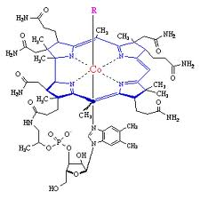
Vitamin B₁₂ (Cobalamin)
Corrin ring structure with central Co ion
Biologically active form: Methylcobalamin Deoxyadenosylcobalamin
Daily requirement: 1.5 mg/day
Stored in the liver [ 2-3 mg ] attached to transcobalamin I

Slide 6
Occurrence and food sources
Synthesized exclusively in microorganisms [bacteria, fungi and algae]
Absent in plant food unless contaminated
Food sources : Liver, yeast, milk and eggs

Slide 7
Absorption and transport
Absorption :
Vit B₁₂ absorption is mediated by receptor site on the ileum
Free Vit B₁₂ binds with intrinsic factor [IF]
IF is a highly specific glycoprotein produced by the parietal cells of the gastric mucosa
IF-B12 complex binds to specific receptors on the mucosal cells of the terminal ileum

Slide 8
Absorption and transport
Dietary food with Vit B12
HCl and pepsin in stomach
R-Protein
B12
Deodinum
Protease activity
B12
B12
IF
R-Protein
B12
B12
IF
Ileal mucosal cells
B12 –IF complex
B12

Slide 9
Absorption and transport
Transport
Once, absorbed it is transported in the blood bound to transcobalamin II
In the cells free cobalamin is released in to cytosol as hydroxocobalammin
Hydroxocobalammin is converted to
i. methylcobalamin [cytosol]
ii. 5’-deoxyadenosylcobalamin [mitochondria]

Slide 10
Functions of Vit. B₁₂
Transfer methyl groups
Conversion of propionate to TCA intermediate during gluconeogenesis [L-methylmalonyl-CoA to Succinyl- CoA ]
Formation of methionine from homocysteine
During formation of methionine , methy-tetrahydrofolate is converted to H4F
This aids folate metabolism and formation of Purine, pyrimidine and nucleic acid synthesis

Slide 11
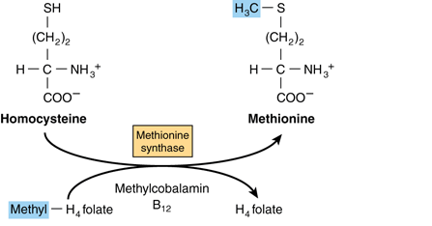
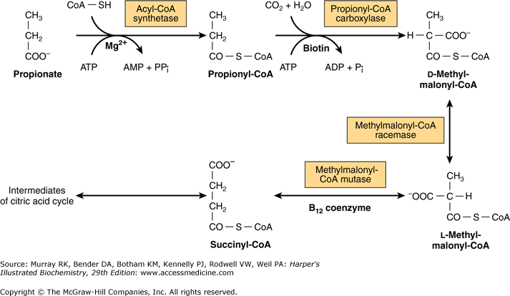
In Cytosol
Hydroxycobalamin
B₁₂
Deoxyadenosylcobalamin
In Mitochindria

Slide 12
Deficiency
1. Accumulation of odd numbered fatty acids and their incorporation into nerve cell members.
Neurological disorders due to progressive demyelination of nerve cells.
2. Artificial folate deficiency (Folate trap)
Drop in nucleotide synthesis and eventually leads to megaloblastic anaemia

Slide 13
Causes of deficiency
Reduced intake [Vegans]
Reduced absorption:
1. Pernicious aneamia :
Common form of B12 deficiency,
Lack of IF /Gastrectomy
Autoimmune disorder
Antibodies againt gastric parietal cells
Antibodies against IF
2. disease of the terminal ileum
3. surgical resection of the gut
4. blind loop syndrome

Slide 14
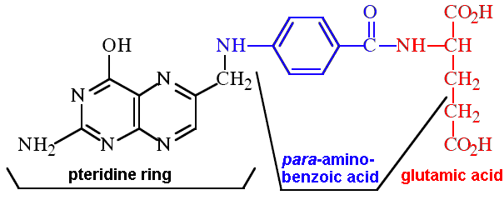
Folic acid [Vitamin B₉]metabolism
Biologically active form: 5,6,7,8-tetrahydrofolate (H₄F)
Plasma level : varies from 3-21 ng/ml
Daily requirement: 200 μg/day
Present in many animal/plant tissues and microorganisms
- Liver, yeast, kidney, fresh green vegetables, fruits, whole grain, meat and fish

Slide 15
Absorption, transport and storage
Absorption :
Polyglutamates are converted into monoglutamate prior to absorption
free folate is absorbed along the whole length of mucosa of small intestine
Upon absorption is enzymatically reduced and methylated to form 5-methy H₄F

Slide 16
Absorption, transport and storage
Transport :
in blood as methyl H₄F bound to specific protein
Storage :
Stored in the liver [ 5 -15 mg ]
Folate is incorporated in the RBC during erythropoiesis and retain during their life span

Slide 17
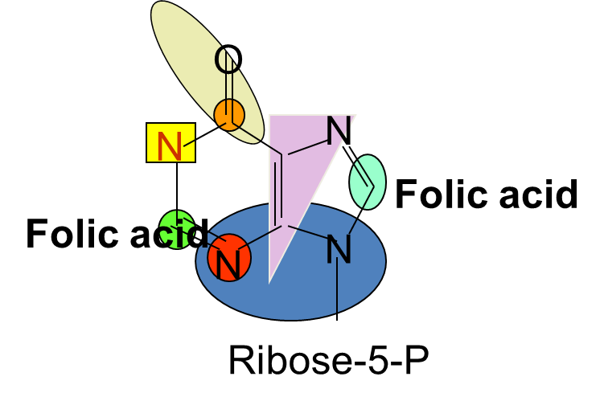
Functions of Folate
Coenzyme in biosynthesis of amino acids : one carbon unit (-CH₃, -CH₂OH,-CHO) transfer
homocystein to methionine – H₄F is a methyl donor
serine to glycine – H₄F is an acceptor of a methyl group from serine
Cell division [growth and development]
DNA and RNA synthesis [biosynthesis of purines and pyrimidines]

Slide 18
Deficiency of folate
Causes
Easily destroyed during cooking
Decreased intake [dieters, alcoholic, elderly]
Increased requirement [pregnancy, lactation, infancy, adolescence, recovery from illness, cancer and haemolytic anemia ]
Malabsorption [coeliac disease]
Drugs :Methotrexate
B 12 deficiency : Folate will be trapped in the methionine salvage pathway “ Folate trap”

Slide 19
Deficiency of folate
Megaloblastic anemia
impaired DNA synthesis leads to impaired cell division and formation of nuclei of RBC
Accumulation of megaloblasts in the bone marrow
Neural tube defects
Notes:
Methylmalonic acid, if not properly handled by B₁₂, remains in the myelin sheath,

Slide 20
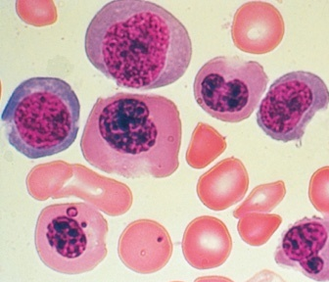
Five years after resection of terminal ileum, a patient was presented with weakness, sore tongue and light headache. Laboratory investigation shows 7 g/dL hemoglobin .
What is the possible cause of this presentation?

Slide 21
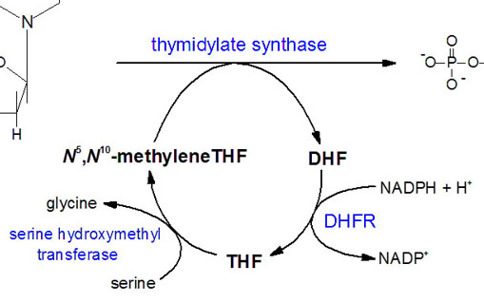
Biochemical basis of megaloblasts formation?
dUMP
dTMP
Methionine
Methionine synthase
B12
Homocysteine
N⁵-MethylTHF
Notes:
Nucleotide Synthesis

